Slide 1
Name:K.R.Shiranjeevi Register no:312211674 Department:commerce College:thiruthangal Nadar

Slide 2
Employee attrition analysis using excel
Agenda:
Employee attrition
Types of Employee attrition
Effects of Employee attrition
All diagrammatic resolutions
Attrition analysis benefits
Calculation of Employee Performance attrition

Slide 3
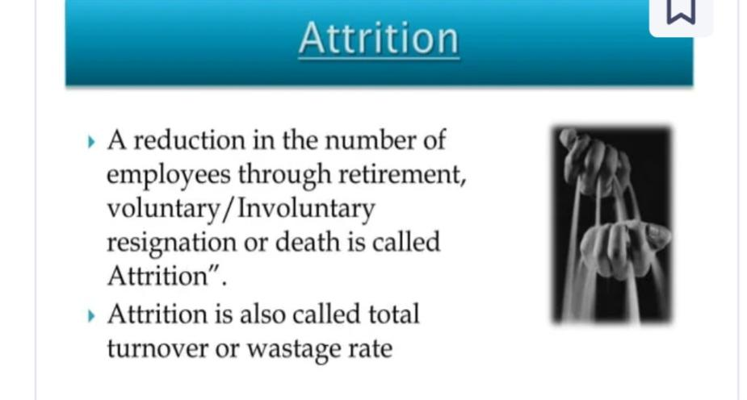
Attrition

Slide 4
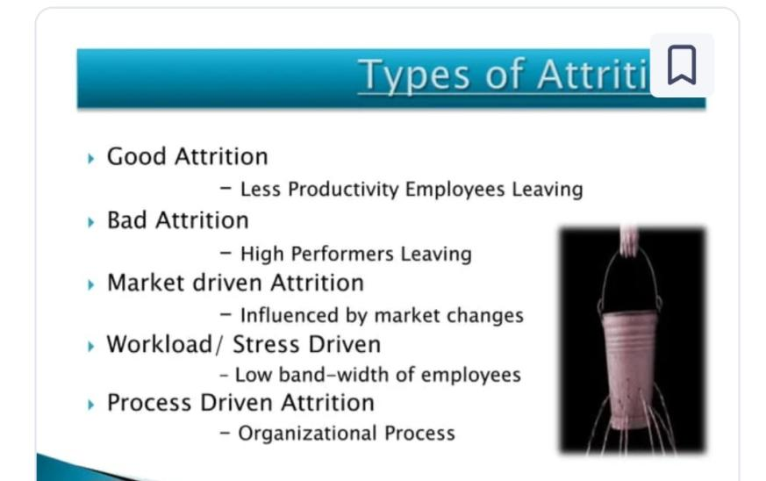
Employee attrition analysis usi

Slide 5
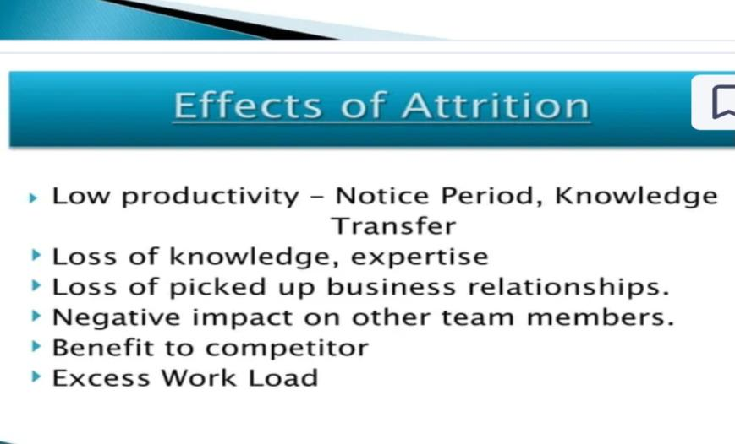

Slide 6
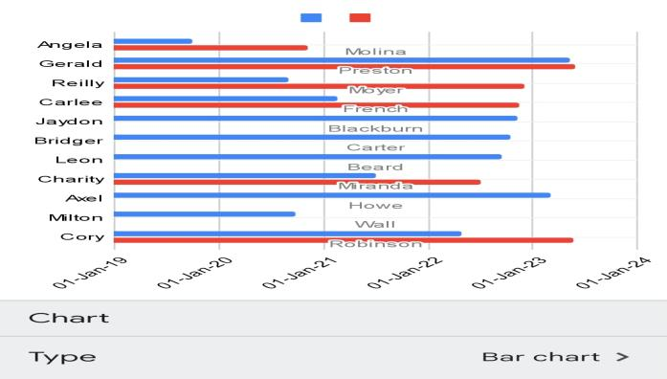
BAR CHART

Slide 7
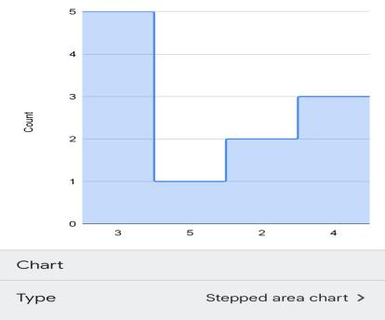
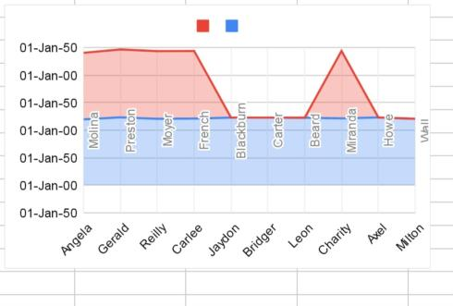
Status of employees

Slide 8
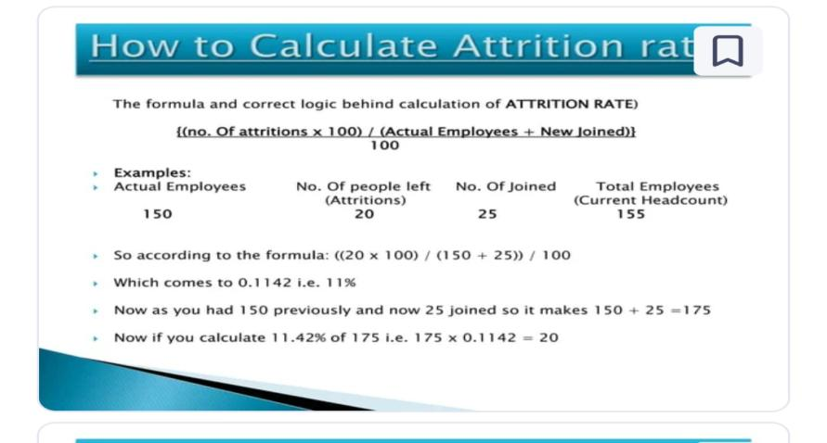

Slide 9
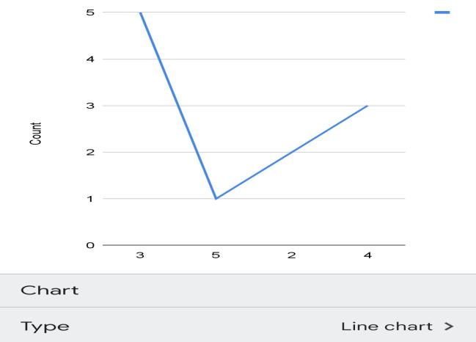
Line chart

Slide 10
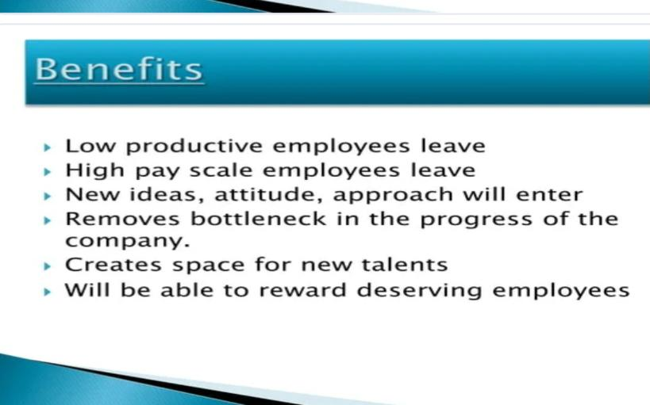

Slide 11
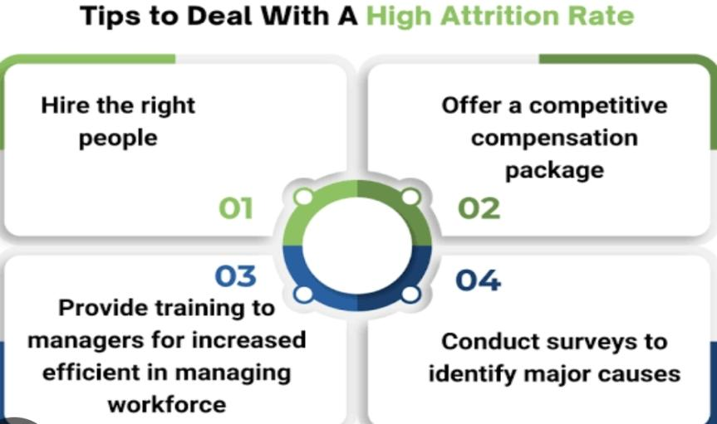

Slide 12
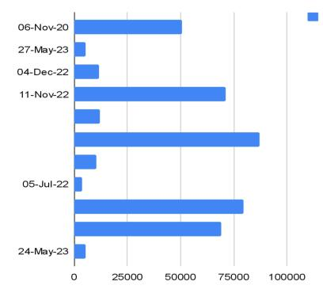
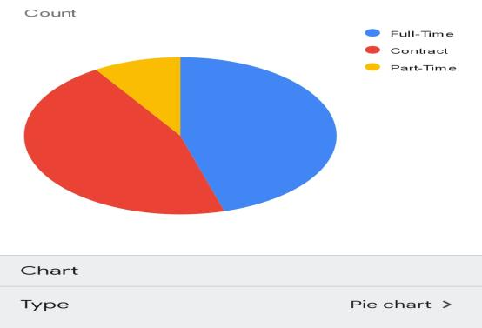
Conclusion

